Slide 1
Firewalls: The Gatekeepers of Cybersecurity
OUTLINE
Overview
Types
Applications
https://intellipaat.com/blog/what-is-a-firewall/?US#no2

Slide 2
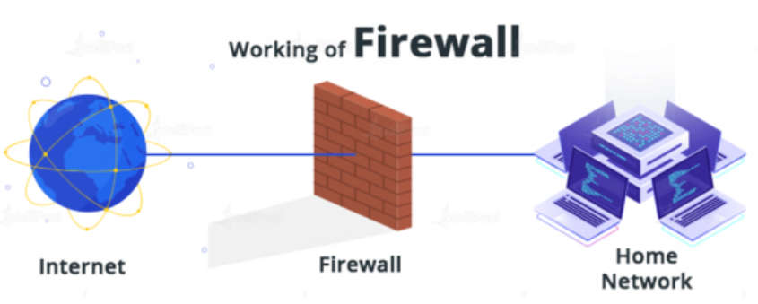
Introduction to Firewalls
A firewall in computer networks is a security system or software that operates as a barrier between an internal network (such as a private local area network, LAN) and external networks (such as the internet).
Its primary purpose is to control and monitor incoming and outgoing network traffic based on a set of pre-determined security rules, policies, and configurations.
Firewalls help effectively manage network traffic and provide defense against potential threats, such as unauthorized access attempts, malware infiltration, and other cyber risks.
Ref: https://intellipaat.com/blog/what-is-a-firewall/?US#no2

Slide 3
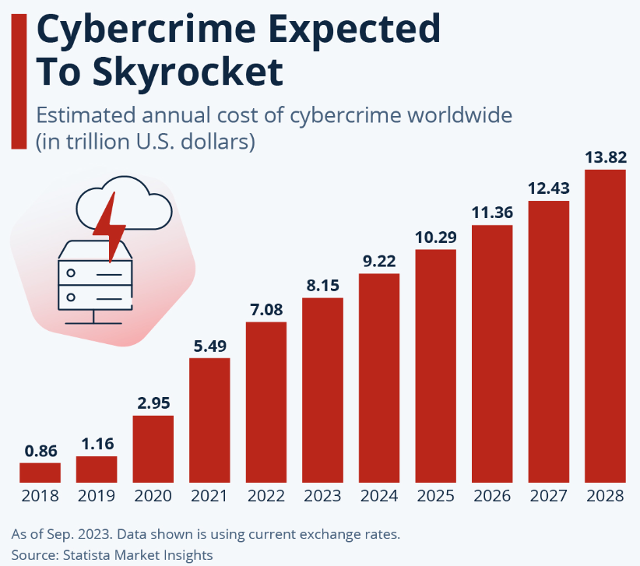
Importance of Firewalls
Why Firewalls are Essential
Protect sensitive data from external threats.
Enforce network segmentation for better control.
Aid compliance with data protection laws (e.g., GDPR, HIPAA).
Statistics
60% of SMBs that suffer cyberattacks go out of business within six months.
Ref: https://www.statista.com/chart/28878/expected-cost-of-cybercrime-until-2027/

Slide 4
Types of Firewalls
Network-Based Firewalls
Host-Based Firewalls
Cloud-Based Firewalls (Firewall-as-a-Service or FWaaS)

Slide 5
Network-Based Firewalls
1) Network-Based Firewalls
A network-based firewall is deployed at the boundary of a network to control traffic between internal and external networks or between different internal segments.
Key Features
Operates at higher throughput to handle traffic for the entire network.
Can be hardware-based (e.g., Cisco ASA) or virtualized (e.g., AWS Security Groups).
Inspects packets for allowed or denied traffic.
Advantages
Provides centralized control over network traffic.
Ideal for enterprise environments with multiple devices.
Disadvantages
High initial cost and maintenance requirements.
Cannot secure individual devices from insider threats.
Examples
Perimeter firewalls protecting corporate networks.
Internal segmentation firewalls isolating sensitive departments.
Use Case
Corporate office with public-facing servers in a DMZ.

Slide 6
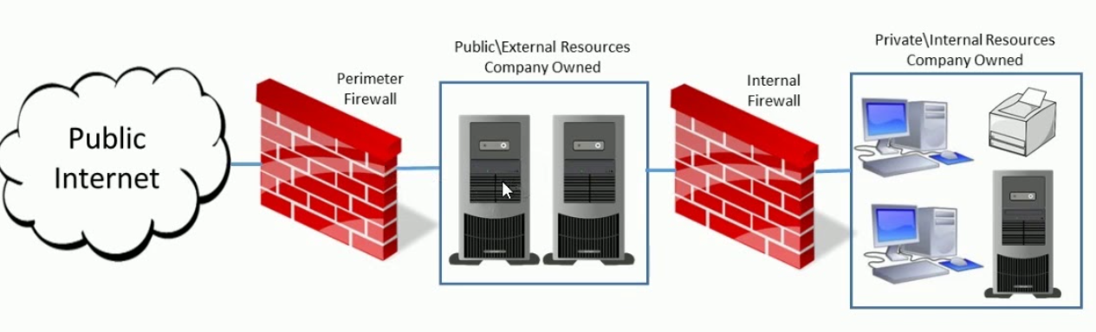
Network-Based Firewalls in DMZ
Ref: https://www.youtube.com/watch?v=iEerh8rAoV0

Slide 7
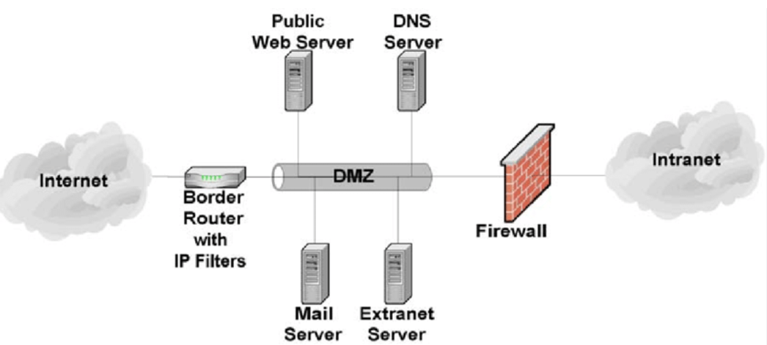
Network-Based Firewalls in DMZ
Ref: Guidelines for Electronic Mail Security – Recommendations of the NIST

Slide 8
Host-Based Firewalls
2) Host-Based Firewalls
A firewall installed on individual devices to monitor and control incoming and outgoing traffic specific to that device.
Key Features
Operates at the device level and enforces security policies locally.
Can filter traffic based on applications, users, or processes.
Advantages
Directly protects endpoints from external threats.
Provides granular control specific to a device’s needs.
Disadvantages
Not suitable for managing multiple devices due to complexity.
Relies heavily on the host’s operating system, which can be exploited.
Examples
Windows Defender Firewall.
Third-party solutions like Norton or McAfee.
Use Case
Laptop firewalls for remote employees accessing public Wi-Fi.

Slide 9
Cloud-Based Firewalls
3) Cloud-Based Firewalls
A cloud-based firewall is deployed on cloud infrastructure to secure distributed and scalable environments. It is often delivered as a managed service by cloud providers or third parties.
Key Features
Operates in virtualized or hybrid environments.
Scalable and integrates with other cloud-native tools.
Protects workloads across multiple regions and environments.
Advantages
Scalability and flexibility to adapt to changing workloads.
Low upfront costs; pay-as-you-go pricing models.
Disadvantages
Dependence on internet connectivity for functionality.
Requires trust in the cloud provider for security and privacy.
Examples
AWS WAF (Web Application Firewall).
Cloudflare Firewall.
Use Case
Protecting microservices in a Kubernetes environment.

Slide 10
Comparison Table
Feature | Network-Based Firewall | Host-Based Firewall | Cloud-Based Firewall
Deployment | Network perimeter or segments | Individual devices | Cloud infrastructure
Use Case | Enterprise networks | End-user devices | Scalable cloud applications
Advantages | Centralized control | Granular endpoint protection | Scalability and low cost
Disadvantages | Expensive, not for insiders | Difficult for multiple devices | Dependence on provider

Slide 11
Packet-Filtering Firewalls
A packet-filtering firewall inspects individual data packets as they traverse the network, applying rules based on header information to decide whether to allow or block the packet. It operates primarily at the Network Layer (Layer 3) and Transport Layer (Layer 4) of the OSI model.
Mechanisms of Packet Filtering
Rule-Based Inspection
Stateless Filtering
Default Policies
Rule Evaluation Order

Slide 12
Rule-Based Inspection
The firewall uses a set of predefined rules, often referred to as Access Control Lists (ACLs), to filter packets.
Rules specify conditions based on:
Source IP address: Where the packet originates.
Destination IP address: Where the packet is headed.
Source Port: Port number on the sender's machine.
Destination Port: Target application/service port (e.g., HTTP on port 80).
Protocol: TCP, UDP, ICMP, etc.

Slide 13
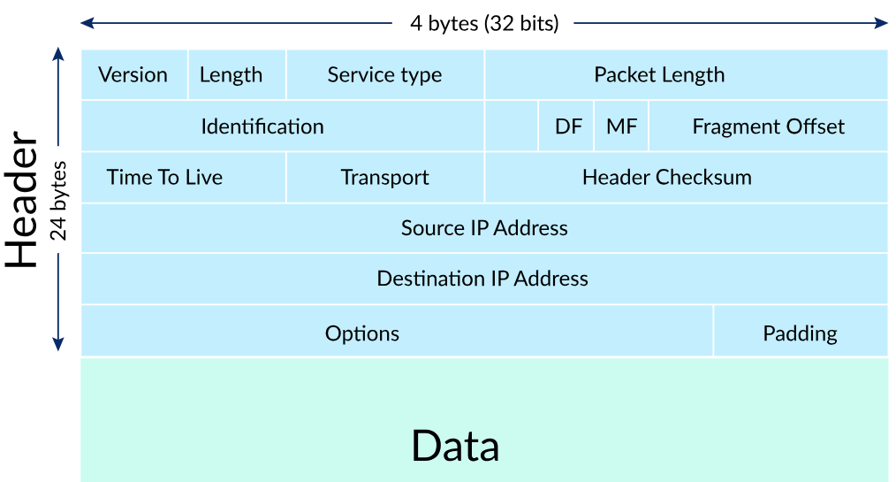
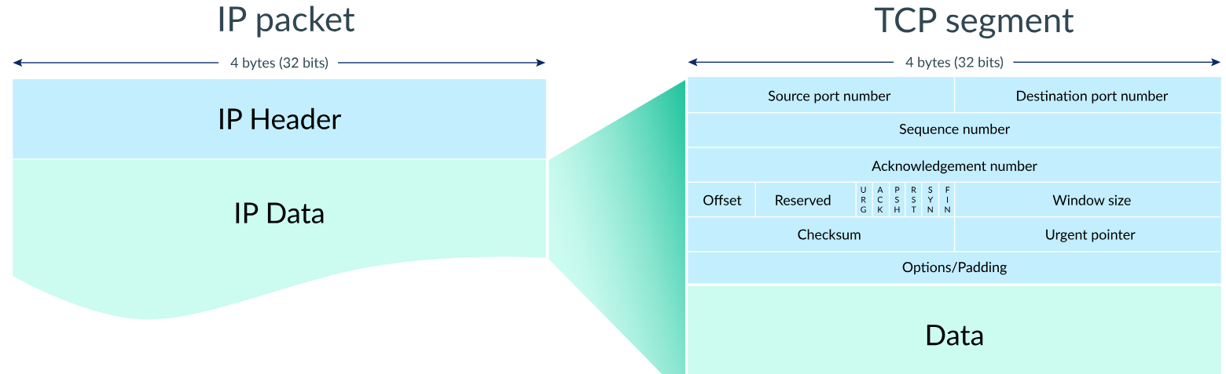
IP Packet and TCP Segment Header
IP Packet Structure
TCP Segment Structure
Ref: https://www.khanacademy.org

Slide 14
ACL Rule Table
Defines rules to permit or deny network traffic based on parameters like IP address, port, and protocol.
Evaluated sequentially; the first matching rule applies.
Rule | Source IP | Destination IP | Protocol | Port | Action
Rule 1 | Any | 192.168.1.1 | TCP | 80 | Allow
Rule 2 | 203.0.113.0 | Any | Any | Any | Deny

Slide 15
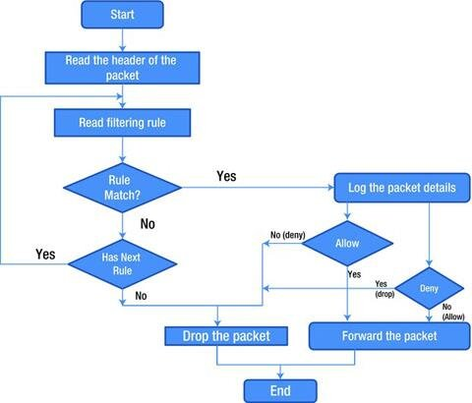
Packet Inspection Flow Against ACL Rules
Ref: https://www.researchgate.net/publication/376831439

Slide 16
Packet-Filtering Firewalls
Stateless Filtering
Each packet is inspected independently, without context about previous packets.
The firewall does not track the state of connections or sessions.
Implication: Fast and efficient but lacks the ability to detect attacks that span multiple packets.
Default Policies
Packet-filtering firewalls implement a default policy to handle packets that don’t match any rules.
Default Deny: Block all traffic unless explicitly allowed.
Default Allow: Permit all traffic unless explicitly denied (less secure).

Slide 17
Packet-Filtering Firewalls
Rule Evaluation Order
Rules are evaluated sequentially, from top to bottom in the ACL.
Once a rule is matched, no further rules are checked.
Example Rule Set:
Allow HTTP (port 80) traffic from any source to the internal web server.
Deny all traffic from specific malicious IP ranges.
Default Deny for all other traffic.

Slide 18
Stateful Inspection Firewalls
A stateful inspection firewall tracks the state of active connections and uses this context to determine whether incoming or outgoing packets should be allowed or blocked.
Key Features:
Examines not just individual packets but the relationship between packets in a connection.
Maintains a state table to record the status of each connection.
Analogy: Think of it as a security guard that remembers who entered the building and lets them exit without re-checking credentials.

Slide 19
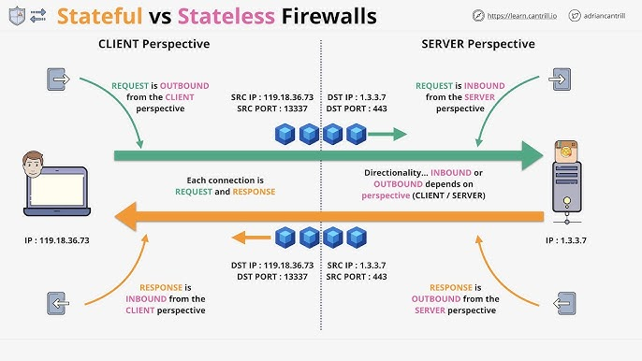
Stateful Inspection Firewalls
Ref: https://www.google.com/images

Slide 20
Mechanism of Stateful Inspection
Connection Tracking
The firewall inspects the initial packet of a connection to check if it matches predefined rules.
If allowed, the connection's details (source/destination IP, port, protocol) are recorded in a state table.
State Table
A database of active connections.
Tracks information like:
Source and destination IP addresses.
Protocol (e.g., TCP/UDP).
Connection state (e.g., established, terminated).
Source IP | Destination IP | Protocol | Port | State
10.0.0.1 | 192.168.1.10 | TCP | 80 | Established

Slide 21
Mechanism of Stateful Inspection
Three-Way Handshake Verification (for TCP)
The firewall monitors the TCP handshake
SYN: Client requests connection.
SYN-ACK: Server acknowledges the request.
ACK: Client confirms the connection.
Only allows traffic after a valid handshake to prevent spoofed or unauthorized packets.
Return Traffic
Automatically allows return traffic (e.g., HTTP response) without re-checking rules because the state table recognizes it as part of an existing connection.

Slide 22
Advantages and Limitations
Advantages
Contextual Filtering: Can block packets that are out of context or do not match the state of an established connection.
Security: More secure than stateless firewalls as it prevents attacks exploiting individual packet filtering.
Efficiency for Established Connections: Faster processing for return traffic, reducing overhead for repetitive checks.
Limitation
Resource-Intensive: The state table requires memory and processing power, especially in high-traffic environments.
Complexity: Requires proper configuration to prevent inadvertent blocking or opening of connections.
Vulnerable to State Table Exhaustion: Attackers can flood the firewall with fake connections (e.g., SYN flood attacks) to overwhelm the state table.

